Slide 1
Sui Course 2023 / Part 6-3

Slide 2
GameMarket Contract

Slide 3
Agenda
Introduction
GameMarket contract
Deployment and testing

Slide 4
GameMarket contract

Slide 5
Introduction
The gameMarket contract provides a basic framework for a game item marketplace, where users can list items for sale, buy items, and collect profits from their sales.
Notes:
The gameMarket contract provides a basic framework for a game item marketplace, where users can list items for sale, buy items, and collect profits from their sales.

Slide 6
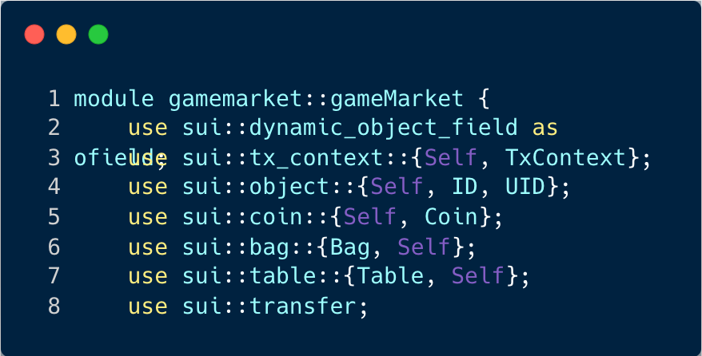
gameMarket Module
Notes:
his section of the code is the beginning of the gameMarket module and includes the import statements for the various libraries and modules that will be used throughout the contract. Here's a breakdown:
module gamemarket::gameMarket: This line declares the start of a new module named gameMarket under the namespace gamemarket.
use sui::dynamic_object_field as ofield;: This line imports the dynamic_object_field module from the sui library and aliases it as ofield for use in the contract.
use sui::tx_context::{Self, TxContext};: This line imports the tx_context module and its TxContext struct from the sui library. TxContext is used to represent the context of a transaction.
use sui::object::{Self, ID, UID};: This line imports the object module and its ID and UID structs from the sui library. ID and UID are used to represent object identifiers and unique identifiers, respectively.
use sui::coin::{Self, Coin};: This line imports the coin module and its Coin struct from the sui library. Coin is used to represent a coin in the contract.
use sui::bag::{Bag, Self};: This line imports the bag module and its Bag struct from the sui library. Bag is used to represent a collection of items in the contract.
use sui::table::{Table, Self};: This line imports the table module and its Table struct from the sui library. Table is used to represent a data structure that maps keys to values.
use sui::transfer;: This line imports the transfer module from the sui library. This module is used for transferring ownership of objects in the contract.

Slide 7
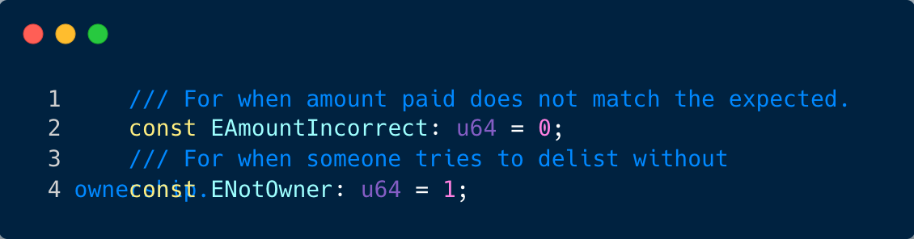
Constant definition
Notes:
This part of the code defines two constants that represent error codes for specific situations in the contract:
EAmountIncorrect: u64 = 0;: This line defines a constant named EAmountIncorrect with a value of 0. This constant is used as an error code to indicate a situation where the amount paid in a transaction does not match the expected amount.
ENotOwner: u64 = 1;: This line defines a constant named ENotOwner with a value of 1. This constant is used as an error code to indicate a situation where someone tries to delist an item from the marketplace without being the owner of that item.
These constants are used in the contract to handle specific error situations and provide clear, meaningful error messages.

Slide 8
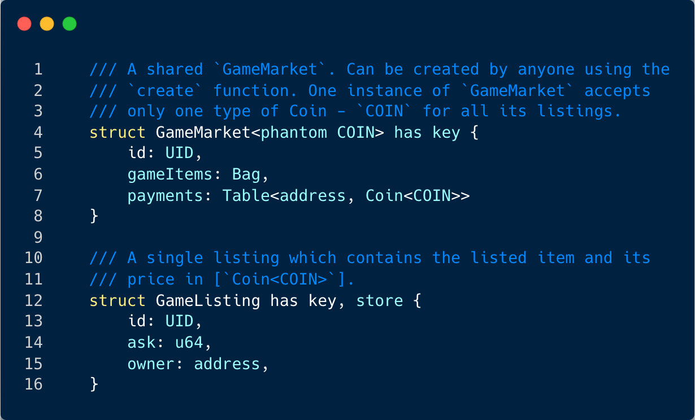
Structs
Notes:
This section of the code defines two data structures, GameMarket and GameListing, which are used to represent a marketplace for games and individual listings within that marketplace, respectively.
struct GameMarket<phantom COIN> has key { ... }: This line defines a structure named GameMarket that represents a shared game marketplace. The GameMarket structure has a phantom type parameter COIN which indicates the type of coin accepted in the marketplace. The GameMarket structure has three fields:
id: UID: A unique identifier for the marketplace.
gameItems: Bag: A bag (collection) of game items available in the marketplace.
payments: Table<address, Coin<COIN>>: A table that maps addresses to their respective payments in the form of Coin<COIN>.
struct GameListing has key, store { ... }: This line defines a structure named GameListing that represents a single listing in the game marketplace. The GameListing structure has three fields:
id: UID: A unique identifier for the listing.
ask: u64: The asking price for the listed item.
owner: address: The address of the owner of the listed item.

Slide 9
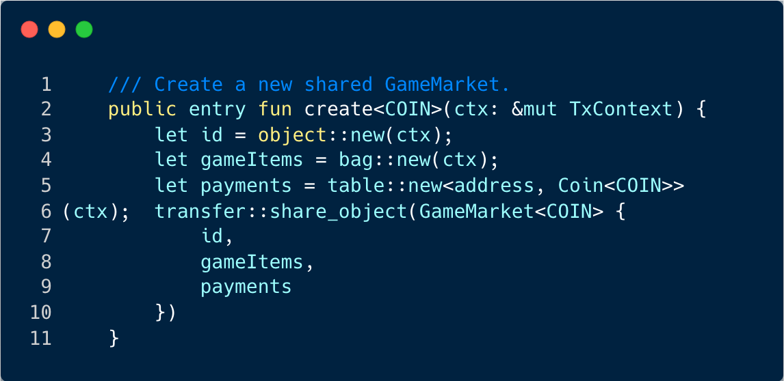
Create a gameMarket
Notes:
This function, create<COIN>(ctx: &mut TxContext), is a public entry function that creates a new instance of the GameMarket structure. It is a generic function that takes a type parameter COIN, which represents the type of coin that the marketplace will accept for transactions. The function also takes a mutable reference to a TxContext object, which represents the context of the transaction in which this function is called.
Here's a breakdown of what the function does:
let id = object::new(ctx);: This line creates a new unique identifier (UID) for the marketplace.
let gameItems = bag::new(ctx);: This line creates a new empty bag (a collection) to store the game items that will be listed in the marketplace.
let payments = table::new<address, Coin<COIN>>(ctx);: This line creates a new empty table to store the payments made in the marketplace. The table maps addresses to their respective payments in the form of Coin<COIN>.
transfer::share_object(GameMarket<COIN> { id, gameItems, payments }): This line creates a new instance of the GameMarket structure with the id, gameItems, and payments that were just created. The GameMarket object is then shared, meaning that it is made accessible to other parts of the program.
In summary, this function initializes a new GameMarket with a unique ID, an empty bag for game items, and an empty table for payments, and then shares this GameMarket object.

Slide 10
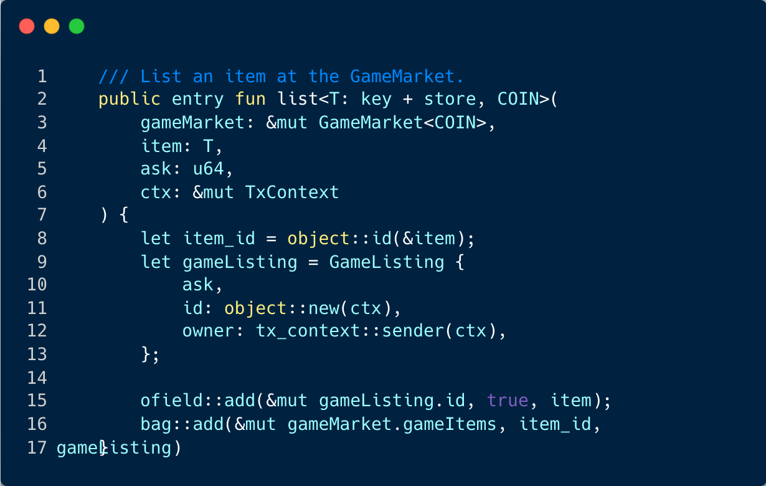
List
Notes:
This function, list<T: key + store, COIN>(gameMarket: &mut GameMarket<COIN>, item: T, ask: u64, ctx: &mut TxContext), is a public entry function that allows a user to list an item on the GameMarket.
Here's a breakdown of what the function does:
let item_id = object::id(&item);: This line retrieves the unique identifier (UID) of the item that is to be listed.
let gameListing = GameListing { ask, id: object::new(ctx), owner: tx_context::sender(ctx), };: This line creates a new GameListing object. The ask field is set to the asking price passed into the function. The id field is set to a new unique identifier. The owner field is set to the address of the sender of the transaction (i.e., the user who is listing the item).
ofield::add(&mut gameListing.id, true, item);: This line adds the item to the GameListing object. The true argument indicates that the item is being added to the GameListing object's dynamic object field.
bag::add(&mut gameMarket.gameItems, item_id, gameListing): This line adds the GameListing object to the gameItems bag of the GameMarket. The GameListing object is associated with the item's unique identifier in the bag.
In summary, this function allows a user to list an item on the GameMarket with a specified asking price. The item is added to a new GameListing object, which is then added to the gameItems bag of the GameMarket.

Slide 11
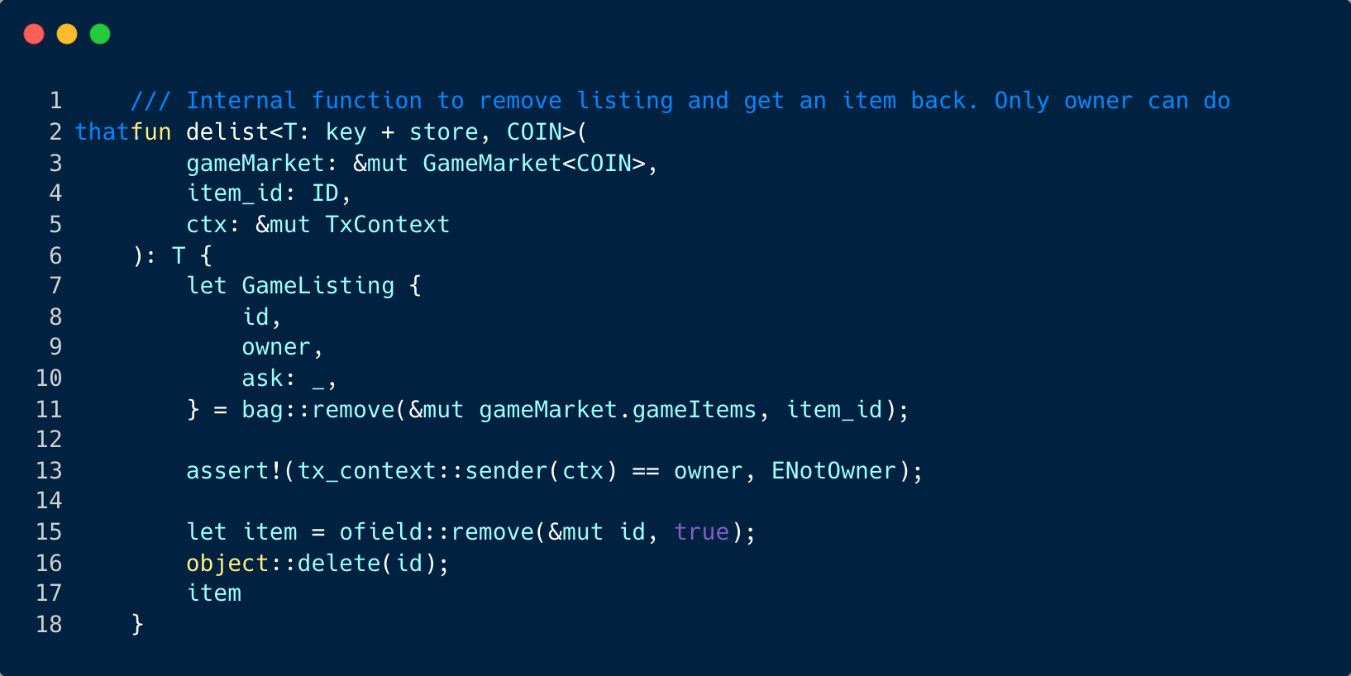
Delist
Notes:
This function, delist<T: key + store, COIN>(gameMarket: &mut GameMarket<COIN>, item_id: ID, ctx: &mut TxContext): T, is an internal function that allows the owner of a listed item to remove the listing and get the item back.
Here's a breakdown of what the function does:
let GameListing { id, owner, ask: _, } = bag::remove(&mut gameMarket.gameItems, item_id);: This line removes the GameListing associated with the given item ID from the gameItems bag of the GameMarket. The removed GameListing is destructured into its id, owner, and ask fields. The ask field is ignored with _ since it's not used in this function.
assert!(tx_context::sender(ctx) == owner, ENotOwner);: This line checks if the sender of the transaction (i.e., the user who is trying to delist the item) is the owner of the item. If not, it throws an assertion error with the ENotOwner error code.
let item = ofield::remove(&mut id, true);: This line removes the item from the GameListing object's dynamic object field.
object::delete(id);: This line deletes the GameListing object.
item: This line returns the item.
In summary, this function allows the owner of a listed item to remove the listing and get the item back. It does so by removing the GameListing from the gameItems bag of the GameMarket, checking that the sender of the transaction is the owner of the item, removing the item from the GameListing, and deleting the GameListing.

Slide 12
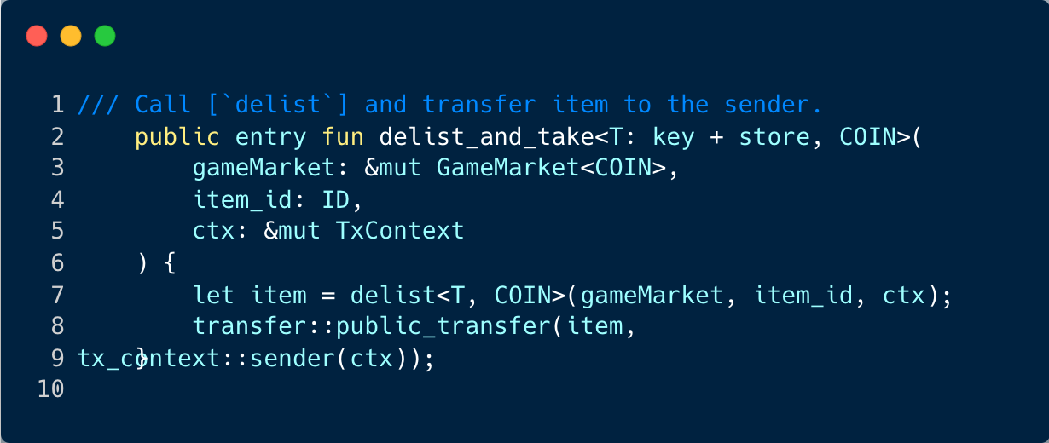
Take back the item
Notes:
The function delist_and_take<T: key + store, COIN>(gameMarket: &mut GameMarket<COIN>, item_id: ID, ctx: &mut TxContext) is a public entry function that allows the owner of a listed item to remove the listing and take back the item.
Here's a breakdown of what the function does:
let item = delist<T, COIN>(gameMarket, item_id, ctx);: This line calls the delist function, which removes the listing from the GameMarket and returns the item. The delist function checks if the sender of the transaction is the owner of the item and throws an error if not.
transfer::public_transfer(item, tx_context::sender(ctx));: This line transfers the item back to the sender of the transaction (i.e., the owner of the item).
In summary, this function allows the owner of a listed item to remove the listing and take back the item. It does so by calling the delist function to remove the listing and return the item, and then transferring the item back to the owner.

Slide 13
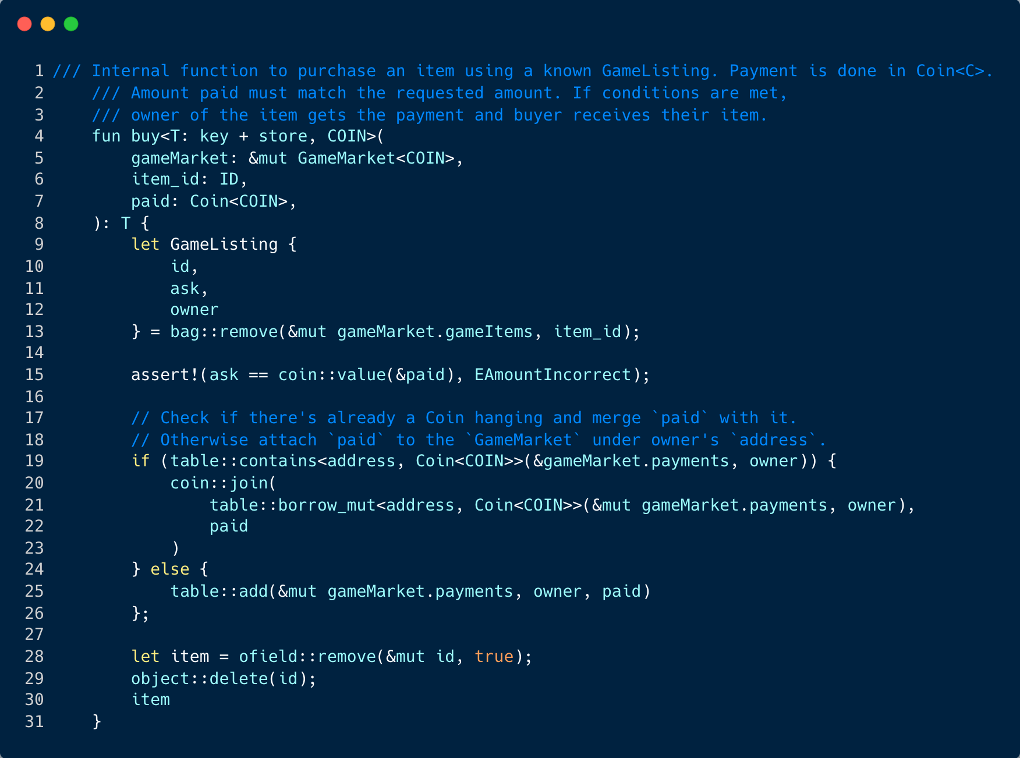
Buy
Notes:
The function buy<T: key + store, COIN>(gameMarket: &mut GameMarket<COIN>, item_id: ID, paid: Coin<COIN>) is an internal function that allows a user to purchase an item from the GameMarket.
Here's a breakdown of what the function does:
let GameListing { id, ask, owner } = bag::remove(&mut gameMarket.gameItems, item_id);: This line removes the GameListing from the gameItems bag in the GameMarket and returns the GameListing. The GameListing contains the id of the item, the price of the item (ask), and the owner of the item.
assert!(ask == coin::value(&paid), EAmountIncorrect);: This line checks if the amount paid matches the asking price of the item. If the amounts do not match, it throws an error.
The next block of code checks if there's already a Coin object associated with the owner's address in the payments table of the GameMarket. If there is, it merges the paid amount with the existing Coin object. If there isn't, it adds a new entry to the payments table with the owner's address as the key and the paid amount as the value.
let item = ofield::remove(&mut id, true); object::delete(id);: These lines remove the item from the GameListing and delete the GameListing.
Finally, the function returns the item.
In summary, this function allows a user to purchase an item from the GameMarket by removing the GameListing from the gameItems bag, checking if the amount paid matches the asking price, updating the payments table, and returning the item.

Slide 14
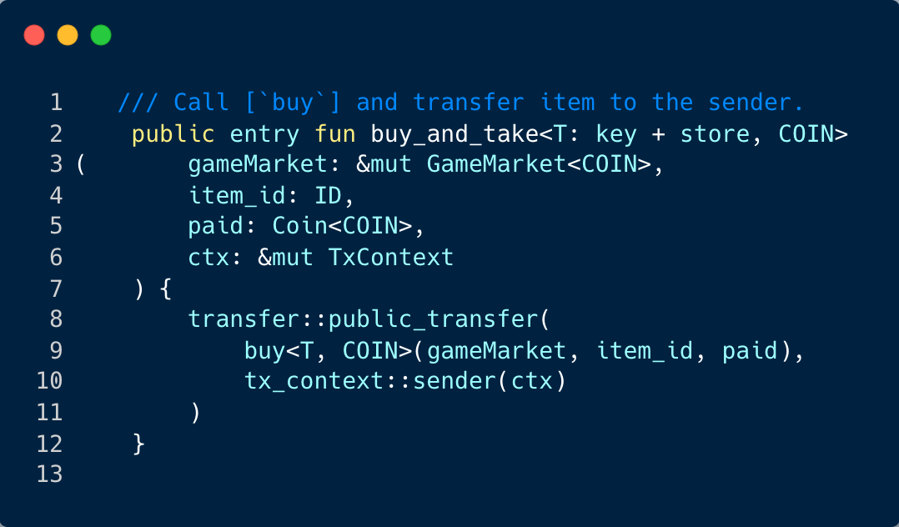
Purchase
Notes:
The function buy_and_take<T: key + store, COIN>(gameMarket: &mut GameMarket<COIN>, item_id: ID, paid: Coin<COIN>, ctx: &mut TxContext) is a public entry function that allows a user to purchase an item from the GameMarket and then have it transferred to them.
Here's a breakdown of what the function does:
buy<T, COIN>(gameMarket, item_id, paid): This line calls the buy function, which was explained in the previous response. The buy function removes the item from the GameMarket, checks if the amount paid matches the asking price, updates the payments table, and returns the item.
transfer::public_transfer(item, tx_context::sender(ctx)): This line transfers the item that was returned by the buy function to the sender of the transaction. The sender is retrieved using tx_context::sender(ctx).
In summary, this function allows a user to purchase an item from the GameMarket and have it transferred to them in one transaction.

Slide 15
Purchase
Notes:
The function buy_and_take<T: key + store, COIN>(gameMarket: &mut GameMarket<COIN>, item_id: ID, paid: Coin<COIN>, ctx: &mut TxContext) is a public entry function that allows a user to purchase an item from the GameMarket and then have it transferred to them.
Here's a breakdown of what the function does:
buy<T, COIN>(gameMarket, item_id, paid): This line calls the buy function, which was explained in the previous response. The buy function removes the item from the GameMarket, checks if the amount paid matches the asking price, updates the payments table, and returns the item.
transfer::public_transfer(item, tx_context::sender(ctx)): This line transfers the item that was returned by the buy function to the sender of the transaction. The sender is retrieved using tx_context::sender(ctx).
In summary, this function allows a user to purchase an item from the GameMarket and have it transferred to them in one transaction.

Slide 16
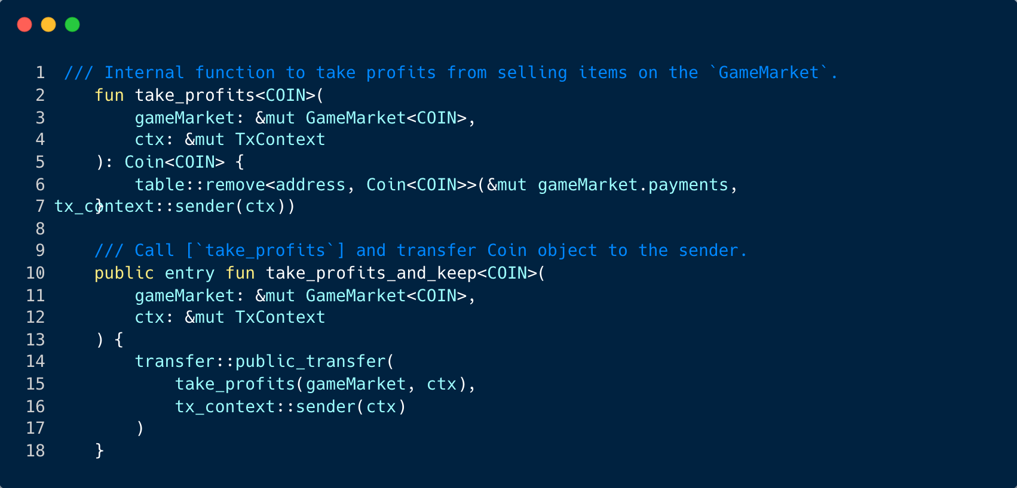
Take profits
Notes:
The take_profits<COIN>(gameMarket: &mut GameMarket<COIN>, ctx: &mut TxContext): Coin<COIN> function is an internal function that allows the owner of the GameMarket to take the profits from selling items on the market. Here's a breakdown of what the function does:
table::remove<address, Coin<COIN>>(&mut gameMarket.payments, tx_context::sender(ctx)): This line removes the entry in the payments table that corresponds to the sender of the transaction (i.e., the owner of the GameMarket). The payments table stores the profits from selling items on the market. The function returns the Coin<COIN> object that was removed from the payments table.
The take_profits_and_keep<COIN>(gameMarket: &mut GameMarket<COIN>, ctx: &mut TxContext) function is a public entry function that allows the owner of the GameMarket to take the profits from selling items on the market and keep them. Here's a breakdown of what the function does:
take_profits(gameMarket, ctx): This line calls the take_profits function, which was explained above. The take_profits function removes the entry in the payments table that corresponds to the sender of the transaction and returns the Coin<COIN> object that was removed.
transfer::public_transfer(take_profits(gameMarket, ctx), tx_context::sender(ctx)): This line transfers the Coin<COIN> object that was returned by the take_profits function to the sender of the transaction. The sender is retrieved using tx_context::sender(ctx).
In summary, the take_profits_and_keep function allows the owner of the GameMarket to take the profits from selling items on the market and keep them in one transaction.

Slide 17
Deployment and Testing

Slide 18
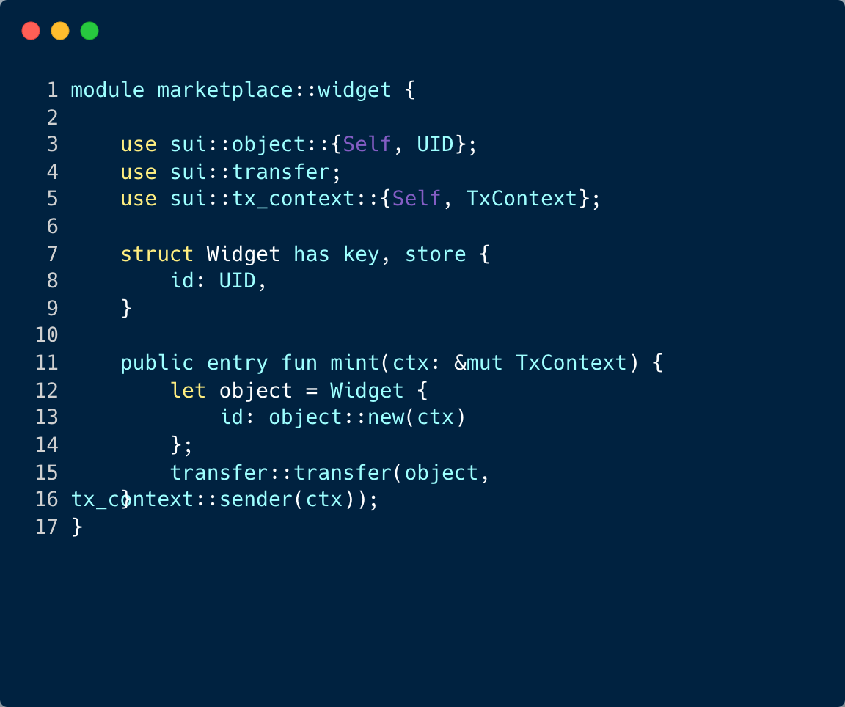
Setting Up the Environment
Notes:
Following this, we have the ability to deploy and evaluate our gameMarket contract using the SUI Command Line Interface (CLI).
We establish a straightforward gameMarket::widget module which allows us to generate some items for listing, aiding in our testing process.
This module defines a simple Widget struct and a mint function for creating (or "minting") new Widget objects on the blockchain.
Widget is a struct that represents a widget in the gameMarket. It has a unique identifier (id).
mint is a public function that creates a new Widget object and transfers it to the sender of the transaction. The ctx parameter is a mutable reference to the transaction context, which provides access to transaction-related information such as the sender's address. The object::new(ctx) function call creates a new unique identifier for the Widget, and the transfer::transfer(object, tx_context::sender(ctx)) function call transfers the Widget to the sender.
We also need to prepare some test coins for the process. The following script can be used to acquire these test coins.
curl --location --request POST 'https://faucet.devnet.sui.io/gas' \
--header 'Content-Type: application/json' \
--data-raw '{
"FixedAmountRequest": {
"recipient": "your address"
}
}'

Slide 19
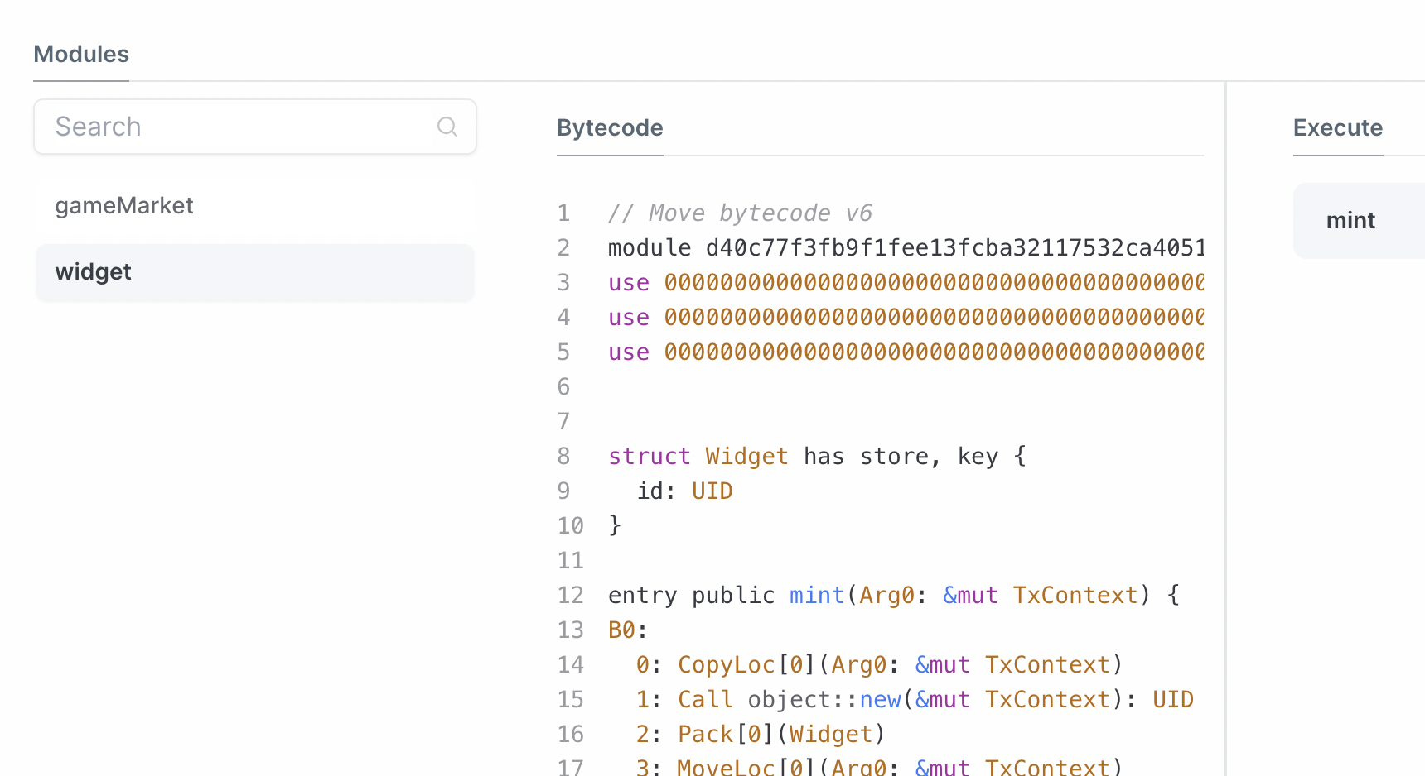
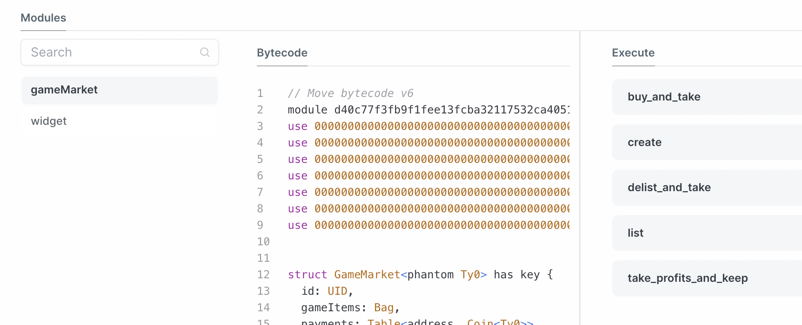
Deployment
Initially, we deploy the package using the following command:
sui client publish --gas-budget 10000000000
Notes:
Initially, we deploy the package using the following command:
sui client publish --gas-budget 10000000000
It's important to note that in the Dev network, the gas fee should be set to the maximum. If it's not, you may encounter errors.
After executing this, you should be able to observe both the gameMarket and widget modules being published on the explorer.
Set the package object ID as an environment variable with the following command:
export PACKAGE_ID=<package object ID>

Slide 20
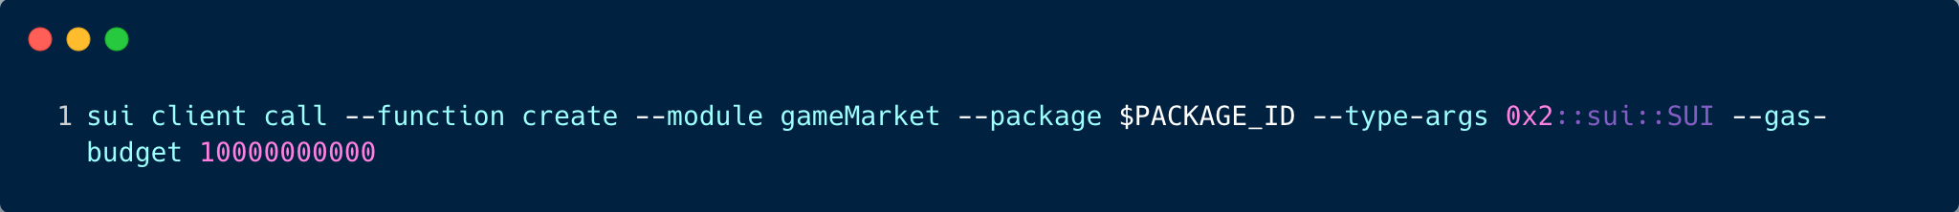
Setting up the gameMarket
Notes:
The next step involves initializing the gameMarket contract by invoking the 'create' entry function. We need to provide it with a type argument to designate the type of fungible token this gameMarket will accept. For simplicity, we'll use the native Sui token. This can be achieved with the following CLI command:
sui client call --function create --module gameMarket --package $PACKAGE_ID --type-args 0x2::sui::SUI --gas-budget 10000000000
Store the ID of the shared gameMarket object as an environment variable:
export MARKET_ID=<gameMarket shared object ID >

Slide 21
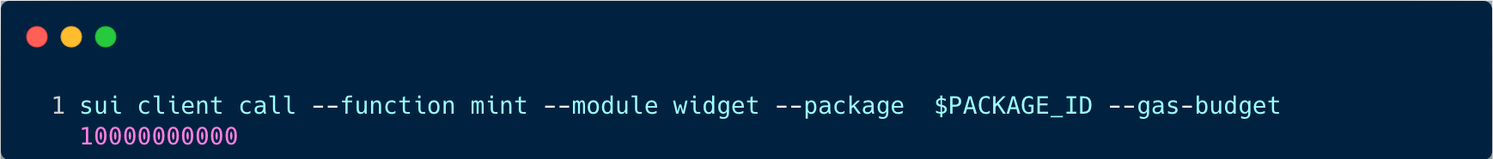
Create a widget item
Notes:
we create a widget item to be listed:
Preserve the object ID of the minted widget as an environment variable:
export ITEM_ID= object ID

Slide 22
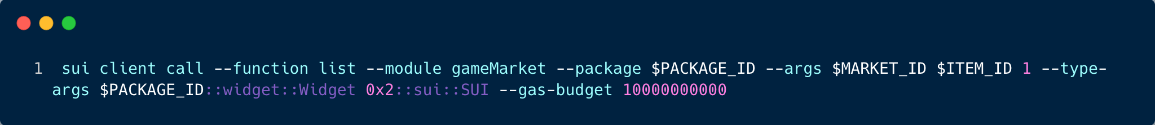
Add item to gameMarket
Notes:
Next, we add this item to our gameMarket:
sui client call --function list --module gameMarket --package $PACKAGE_ID --args $MARKET_ID $ITEM_ID 1 --type-args $PACKAGE_ID::widget::Widget 0x2::sui::SUI --gas-budget 10000000000
Two type arguments need to be provided here: the first one is the type of the item to be listed, and the second one is the type of the fungible coin for payment. In the above example, the listing price is set to 1.
Upon submitting this transaction, you can view the newly created listing on the Sui explorer:

Slide 23
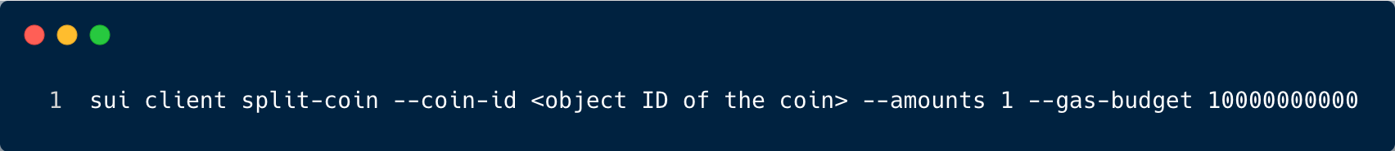
Separate a SUI coin object
Notes:
Separate a SUI coin object of amount 1 to use as the payment object. You can use the sui client gas CLI command to view a list of available SUI coins under your account and select one to split.
sui client split-coin --coin-id <object ID of the coin> --amounts 1 --gas-budget 10000000000
Store the object ID of the newly split SUI coin with a balance of 1 as an environment variable:
export PAYMENT_ID=<object ID of the split 1 balance SUI coin>

Slide 24
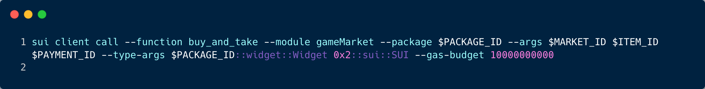
Purchase
Notes:
Next, let's purchase the item we just listed:
sui client call --function buy_and_take --module gameMarket --package $PACKAGE_ID --args $MARKET_ID $ITEM_ID $PAYMENT_ID --type-args $PACKAGE_ID::widget::Widget 0x2::sui::SUI --gas-budget 10000000000
After submitting this transaction, you should see a lengthy list of transaction effects in the console. We can confirm that the widget is now owned by our address, and the payments Table should now contain an entry with our address as the key and a size of 1.

Slide 25
Purchase
Notes:
Next, let's purchase the item we just listed:
sui client call --function buy_and_take --module gameMarket --package $PACKAGE_ID --args $MARKET_ID $ITEM_ID $PAYMENT_ID --type-args $PACKAGE_ID::widget::Widget 0x2::sui::SUI --gas-budget 10000000000
After submitting this transaction, you should see a lengthy list of transaction effects in the console. We can confirm that the widget is now owned by our address, and the payments Table should now contain an entry with our address as the key and a size of 1.

Slide 26
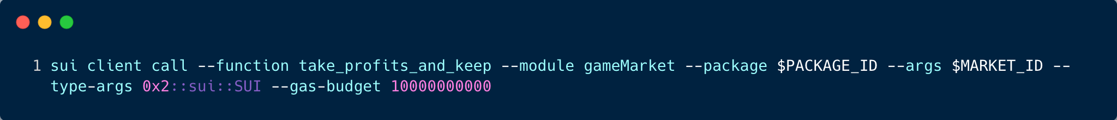
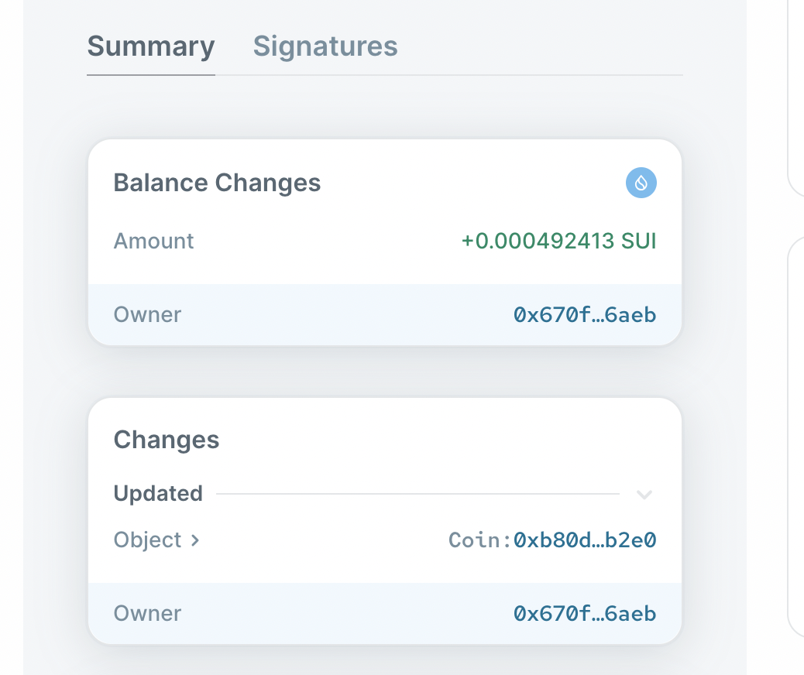
Claiming Profits
Notes:
Lastly, we can collect our profits by invoking the take_profits_and_keep method:
sui client call --function take_profits_and_keep --module gameMarket --package $PACKAGE_ID --args $MARKET_ID --type-args 0x2::sui::SUI --gas-budget 10000000000
This action will withdraw the balance from the payments Table object and reset its size to 0. You can confirm this on the explorer.

